Slide 1
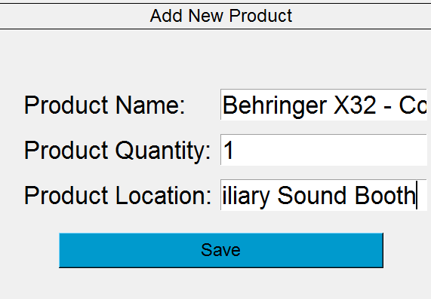
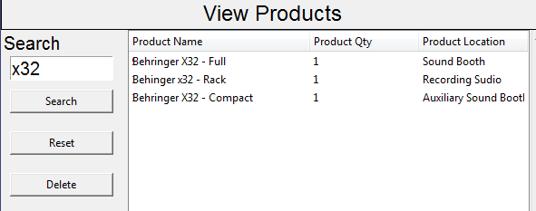
Simple Audio and Video equipment Inventory System
A simple and effect means of tracking the locations and quantities of equipment for a small team.
Project Developer: Jesse Dake
Using code from:
Simple Inventory System by Fabian Ros
Simple Inventory System by sgage24

